Slide 1

CHRIS MACE
ClimateWins – Interim report
November 2025

Slide 2

OBJECTIVE
Use machine learning to help predict the consequences of climate change while working as a data analyst at a European nonprofit organization
Notes:
Keep suspense!
delay before which type chosen
summarise - data could be better

Slide 3
CLIENT
The client, ClimateWins, wants to know:
Can we apply machine learning to weather data?
Can we use machine learning to analyse historic maximums and minimums of temperature?
Can we use machine learning to predict favourable weather conditions on certain days?
All while considering ethical concerns

Slide 4

HYPOTHESES
Machine learning can analyse historic and current data to predict how mean temperature will change in future years
Machine learning can predict if it is favourable to go out on a certain day
Machine learning can predict the risk of a dangerous condition such as high wind speed

Slide 5
DATA
Data collected by ECA&D – European Climate Assessment & Data Set Project
Collects and validates daily climate data from meteorological stations to create datasets used for research, assessments, and understanding climate trends and impacts
Collected from 1960 to 2022 across 18 weather stations in mainland Europe
Main data set includes variables such as wind speed, mean temperature and sunshine for each day. Pleasant weather data set is a yes/no format on if it is good to go out

Slide 6
BIAS AND ACCURACY
Location data purely from mainland Europe (selection bias)
Vested interest of the provider potentially to highlight extremes; human may focus on say the change in temperature over other weather conditions such as windspeed or precipitation (interaction bias)
Human error in data collection and preparation
Accuracy – main weather data set seems complete with records for all 18 stations and their specific conditions, however pleasant weather dataset only for 15, and as we’ll see – one is not useable!

Slide 7
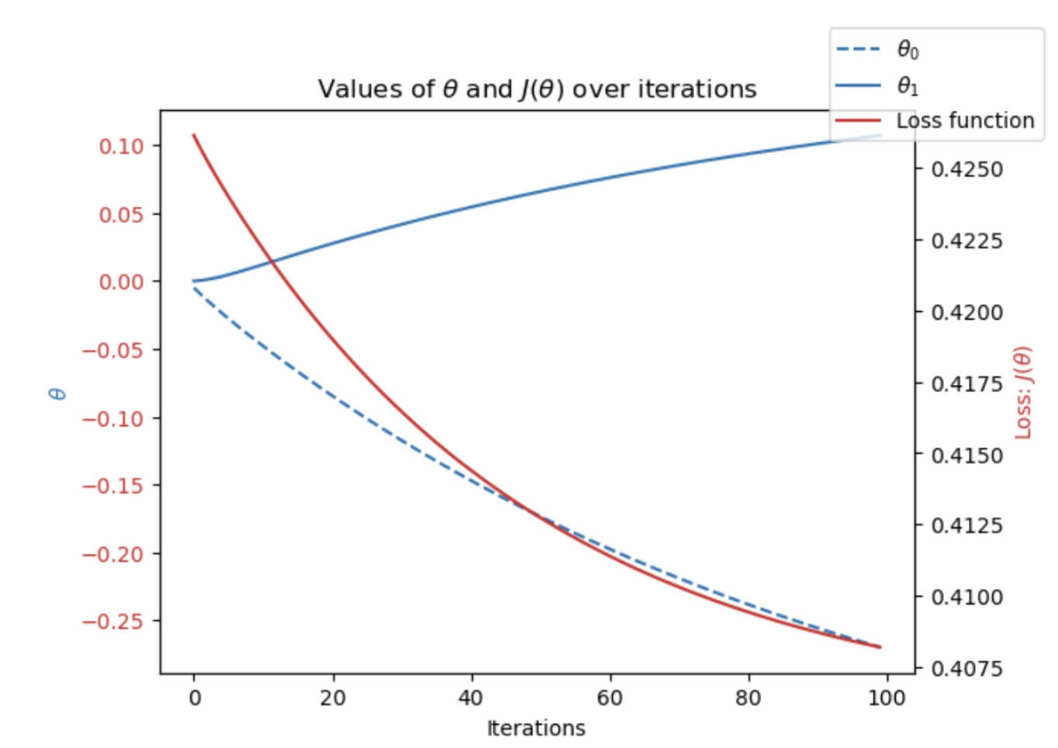
OPTIMISATION
Optimisation, here using the gradient descent method, is used to find the best model parameters.
It enabled us to minimize the the loss function while adjusting parameters such as iterations and step size, to ultimately improve model performance
Best results using scaled data and this will apply to all models

Slide 8
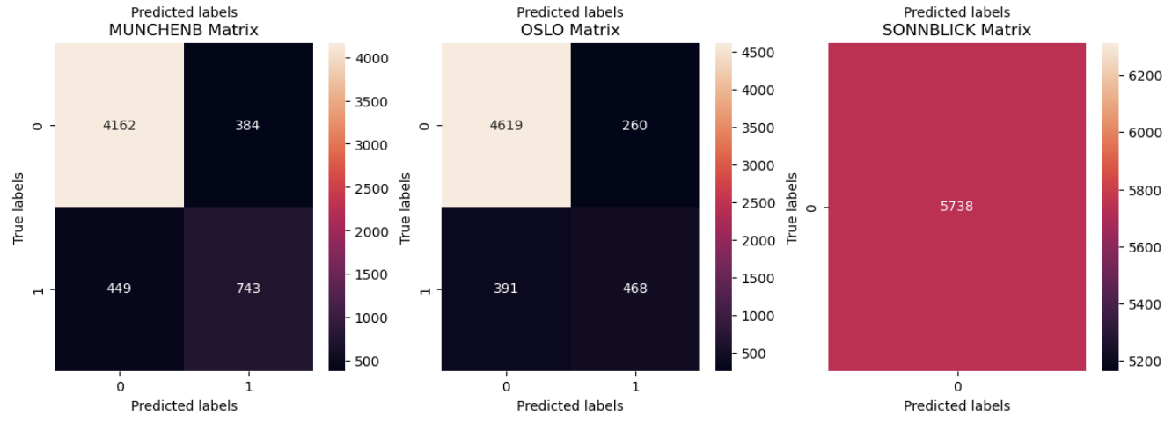
#1 K-nearest neighbour (KNN)
This algorithm is mainly used for classification, and works by measuring proximity between data points and then groups the closest into neighbours
High accuracy – 85-90%
We can already see issue with Sonnblick data set only contains 0s!

Slide 9
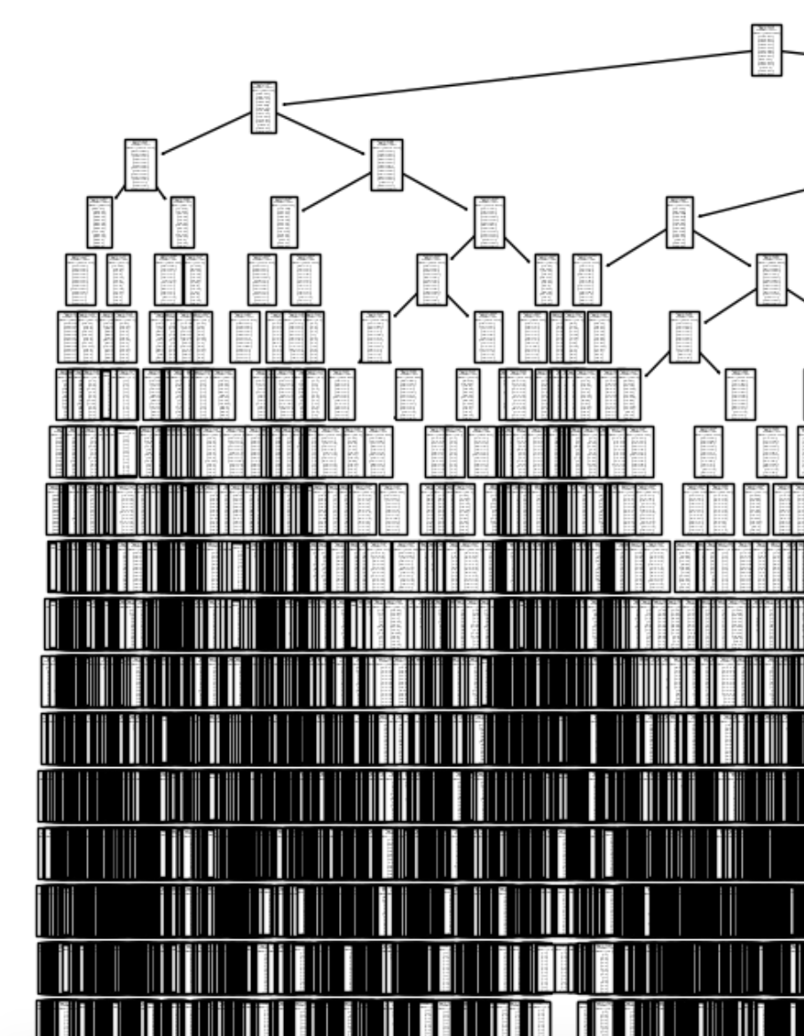
#2 decision tree
This algorithm has a flowchart-like structure used to split data and predict a result, with each node representing a decision point
Difficult to visualise answers, long processing time, low accuracy of around 40%
Pruning required as low accuracy likely from asking too many questions, making it prone to overfitting

Slide 10
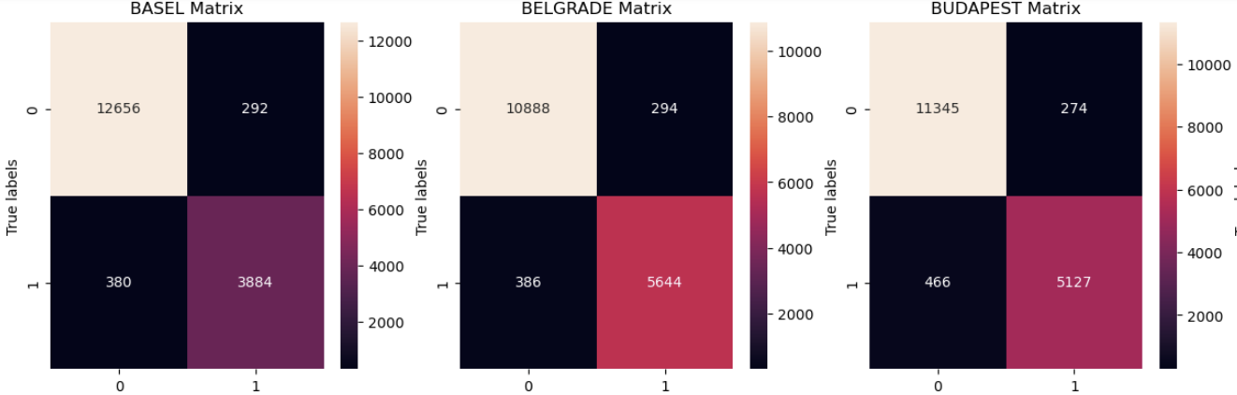
#3 artificial neural network (ANN)
Computational algorithm using interconnected nodes (neurons) organized in layers, which process input data and generate an output, and learns by adjusting the strength of these connections (weights) to improve its performance
I used various levels of parameters (nodes, iterations, and tolerance) in supervising this model Training data maxed out at 72.5%
Potential to improve and this flexibility required for our hypotheses

Slide 11
Preferred type
While KNNs present higher accuracy, this is limited to simple classification. ANNs will be more useful over time as will scale better and learn complex weather data
ANNs can handle more variables, and we shall need to factor in all conditions when determining if the weather is suitable or potentially dangerous, and support or reject our hypotheses

Slide 12
SUMMARY
Hypotheses to be analysed using ANNs:
Machine learning can analyse historic and current data to predict how the mean temperature will change in future years
Machine learning can predict if it is favourable to go out on a certain day
Machine learning can predict the risk of a dangerous condition such as high wind speed
Next steps and future analysis:
Contact data collector to review how the data was prepared and minimise potential bias, especially for Sonnblick!
Investigate advanced methods using ANNs to answer hypotheses

Slide 13
Questions? Chris mace chrismace888@gmail.com
THANK YOU!

